Slide 1
Royalty / Rental Income
4491-12 Income - Royalty and Rental Income v11.0 VO.pptx
Form 1040 Line 17
Pub 4012 Tab 2

Slide 2
Royalty/Rental Income Schedule E
Royalty and/or rental income for oil leases with no expenses is IN SCOPE
Royalties can be reported on either K-1 or 1099-MISC
Rent can be reported on 1099-MISC
Rent reported on K-1 is OUT OF SCOPE
Rental income on residential property is OUT OF SCOPE

Slide 3
1099-MISC in TAXWISE

Slide 4
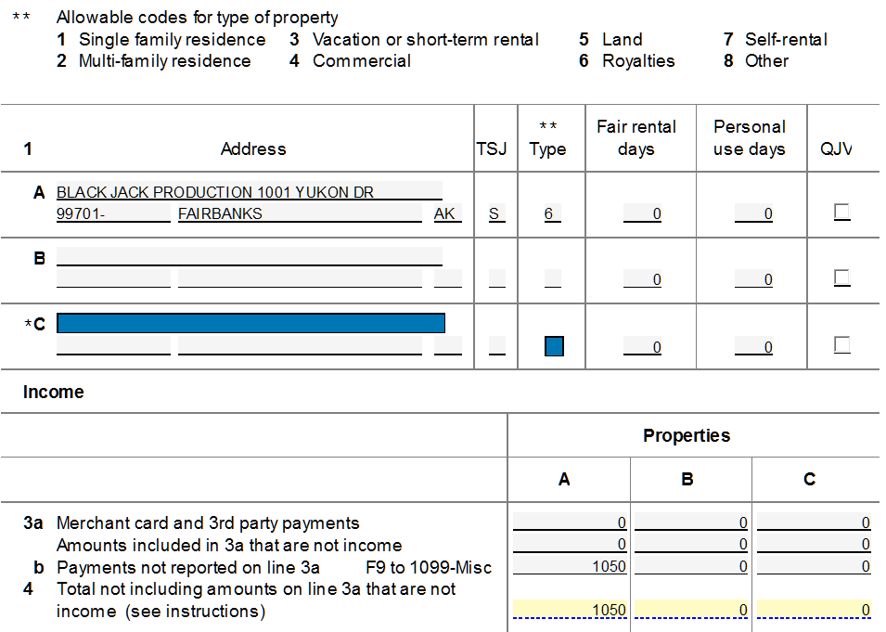
SCH E in TAXWISE
Link to 1099-MISC

